Slide 1
Chap 5: Pointers and Arrays
Lecture1: Pointers and 1D array

Slide 2

Introduction
Program = Algorithm + Data structure
Subsequent, selection and loop blocks of statements.
Function: a group of statements achieves a specific task.
Nikiklaus Wirth
Notes:
凭借一句话获得1984图灵奖的Pascal之父——Nicklaus Wirth，让他获得图灵奖的这句话就是他提出的著名公式：“算法+数据结构=程序”。
这个公式对计算机科学的影响程度足以类似物理学中爱因斯坦的“E=MC^2”——一个公式展示出了程序的本质。

Slide 3
Introduction
Program = Data structure +Algorithm
Data structure
Data Types
Derived
Types
Fundamental
Types
User-defined
Types
Arrays
Pointers
Integral Types
Float / double
Character Types
Structures
Unions
Enumerations

Slide 4

Introduction
An array is a fixed-size sequenced collection of elements of the same data type.
Examples:
float height[50];
int number[5];
double scores[STU_NUM]; /*#define STU_NUM 60*/
int n = 100;
char string[ n ];

Slide 5
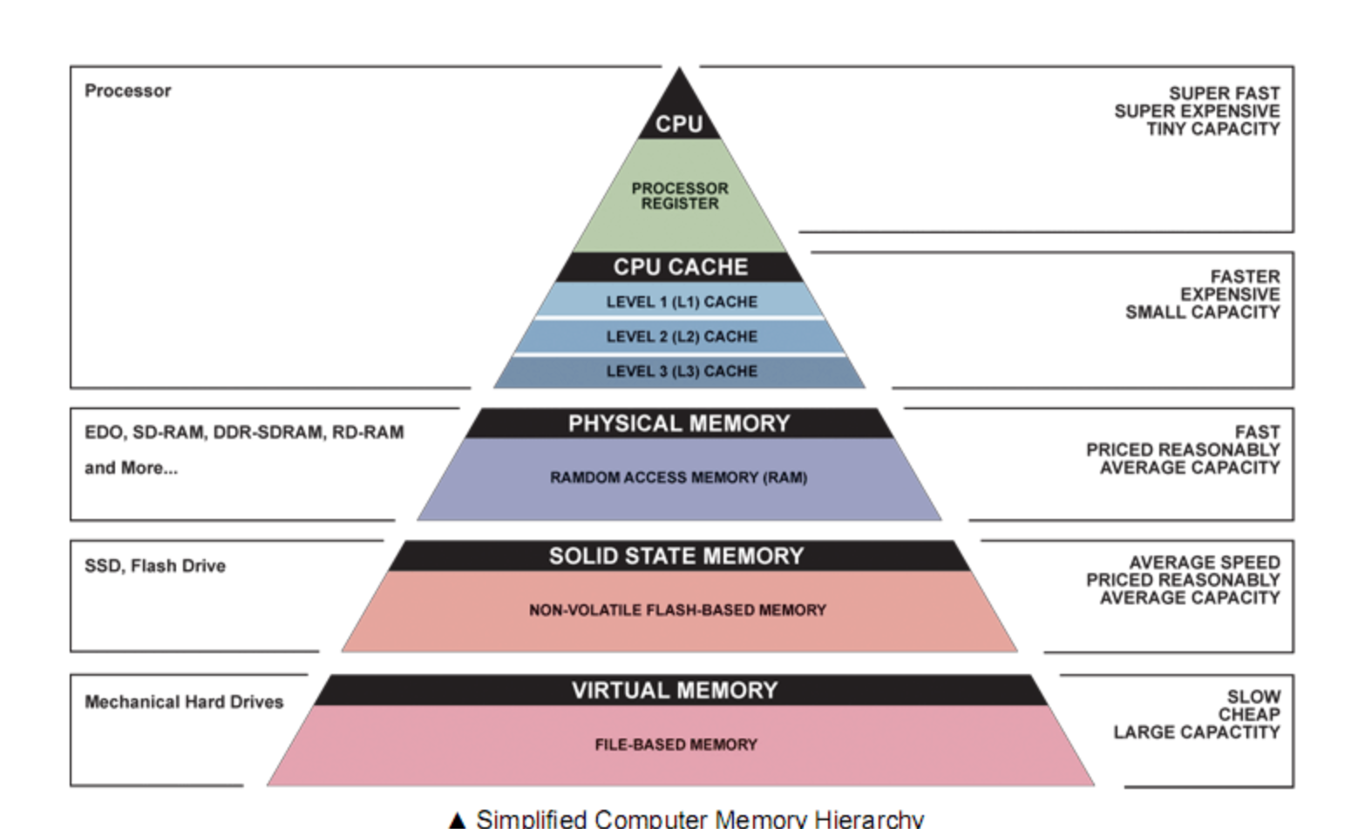
Introduction
A pointer is nothing but a variable that holds (contains)
an address, which is a location of an object in memory.

Slide 6
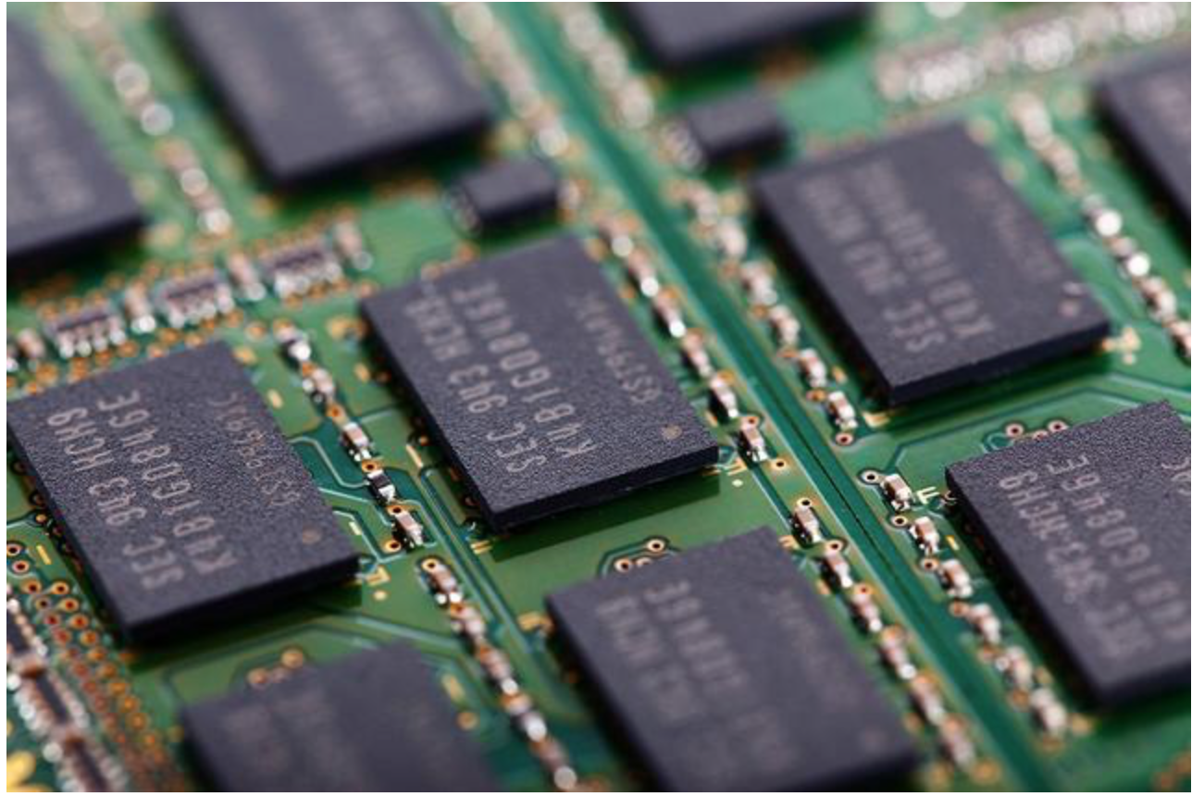
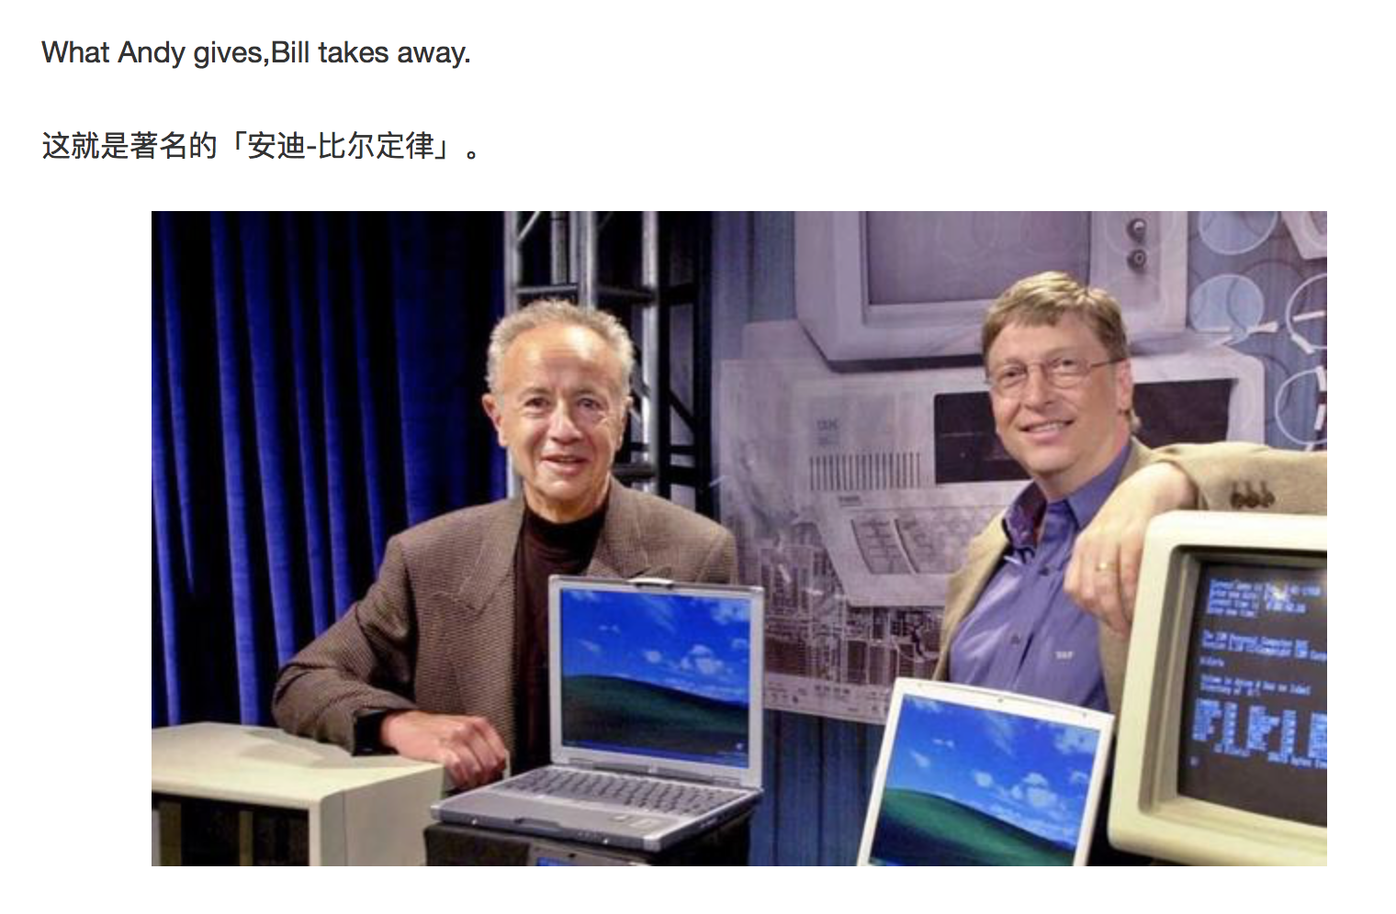
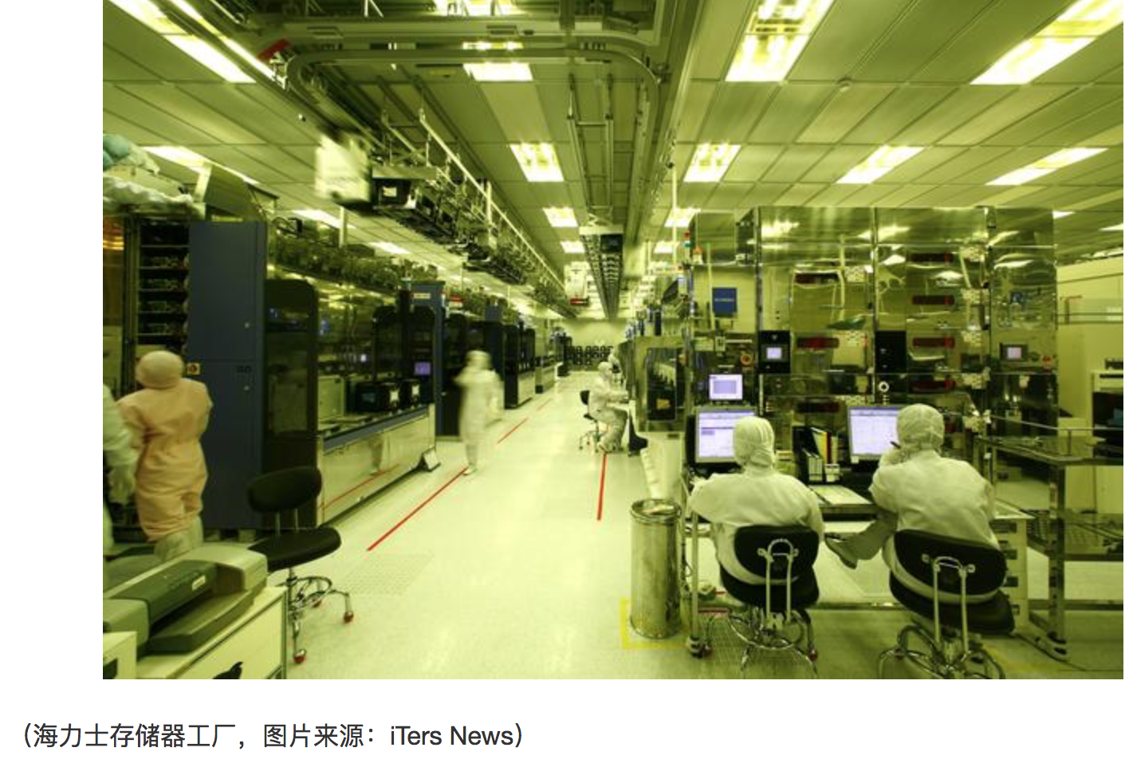
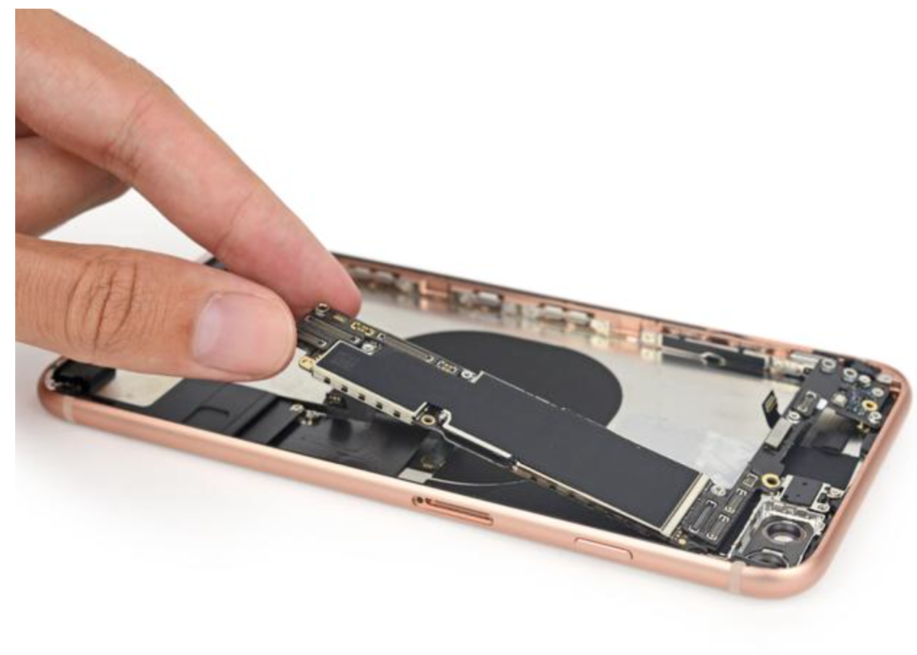
Notes:
安迪-比尔定理 （Andy and Bill’s Law）
IT产业中软件和硬件升级换代关系的一个概括。安迪指英特尔前CEO Andy Grove，比尔指微软前任CEO比尔·盖茨，这句话的意思是，硬件提高的性能，很快被软件消耗掉了。

Slide 7
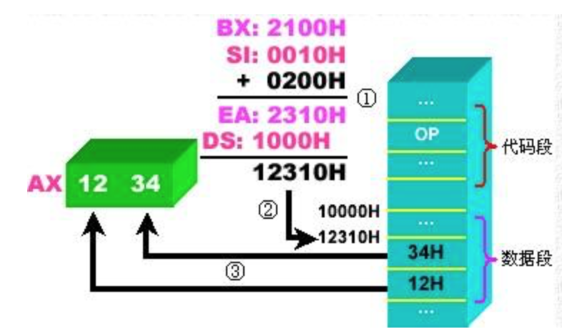
Introduction
A pointer is nothing but a variable that holds (contains)
an address, which is a location of an object in memory.
Pointers are one of the most distinct and exciting features of C language.
Pointers are a powerful tool that adds flexibility and efficiency to
the language although they appear a little confusing and difficult to
understand for beginners.

Slide 8
Understanding pointers
char str[3] 0X0066FDEF
int * pt 0X0066FDD0
int a 0X0066FDF4
Notes:
内存的概念
内部存储器( Memeory )是由存储单元组成的。它的特点是存储单元是线性连续的。
存储单元的最小单位是字节Byte。
地址的概念
为了访问内存中的某个存储单元要为它编号，这种编号称为内存地址Address。
通过地址就能够访问该地址所标识的存储单元

Slide 9
Understanding pointers
int quantity = 1024;
Find a location for the integer variable, with the name quantity and puts the value 1024 in that location.
A computer identifies locations by their addresses.
Each byte has a unique address represented by an integer.
We may assign this integer to a variable and use it.
This variable is called a ‘pointer’, which points other object.
Memory Cell (byte)
0
1024
1
.
1
.
2³²-1

Slide 10
Pointer declaration and initialization
pt_name points to a variable of type data_type
General form
data_type *pt_name;
Example:
int *p = &quantity;
pt_name needs a memory location
The * tells that the variable is a pointer variable
0
quantity
1024
1
.
p
1
.
2³²-1

Slide 11
Access the address of a variable
The & operator can be used only with a variable or an object with accessible memory.
int x[10]; p = &x[0]; p = &x[1];
125(pointing at constants) NO
int x[10]; &x (pointing at array names) NO
&(x+y)(pointing at expressions) NO
Every pointer points to a specific data type.
char name[10], * pt = name;
int a = 3; float *p = &a; NO(?)

Slide 12
Dereferencing operator
The unary operator * accesses the object to which the pointer points.
General form: precede to a pointer variable
*pointer_name
If a pointer points to the valid address of a variable, *pointer_name can be used in any context where the variable could (can be used as a variable name).
Can *pointer_name be a l-value?
Pay attention to the difference between the declaration of a pointer and dereference operator
int a = 3, *p;
p = &a;
printf(“%d”, *p);

Slide 13
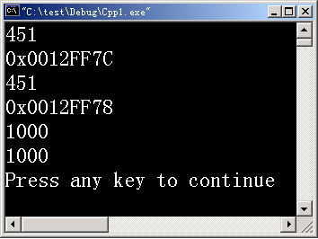
Dereferencing operator
int a = 451, b =1000 ;
printf(“%d\n”, a);
printf(“%x\n”, &a);
printf(“%d\n”, *(&a) );
int *iPtr = &b ;
printf(“%p\n”, ? );
printf(“%d\n”, ? );
printf(“%d\n”, ? );
iPtr, &b,
*iPtr, b,
*&iPtr, &*iPtr
*&b, &*b
18/12/6

Slide 14
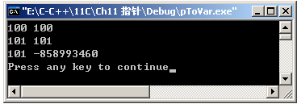
Dereferencing operator
p
num
int *p = 0, num = 1;
p = &num;
*p = 100;
printf(“%d %d\n”, num ,*p );
(*p) ++;
printf(“%d %d\n”, num ,*p );
num = *p --;
printf(“%d %d\n”, num ,*p );
&num
100
num++;
*(p--)
num = *p; p-- ;
18/12/6

Slide 15
An example to illustrate pointers
#include <stdio.h>
#define NULL 0
int main()
{
int i1=3,i2=4;
int *p1,*p2,*p = NULL ;
p1=&i1; p2=&i2;
/*Swap the values of pointer variables*/
p=p1; p1=p2; p2=p3;
printf("i1=%d\ni2=%d\n",i1,i2);
printf("*pi1=%d\n*pi2=%d\n",*p1,*p2);
printf(“ pi1=%d\n pi2=%d\n”, p1,p2);
return 0;
}
* p2
p1
* p1
* p
&i2
10
i1
&i1
p
&i1
* p2
p2
* p1
&i2
20
i2
&i1

Slide 16
Figure demonstration
int i1=3,i2=4;
int *p1,*p2,*p;
p1=&i1 ; p2=&i2; p = 0;
pi3=pi1; pi1=pi2; pi2=pi3;
int i1=3,i2=4;
int *p1=&i1,*p2=&i2,*p = 0;
*p=*p1; *p1= *p2; *p2= *p;

Slide 17
Pointer dereferencing in swap
#include <stdio.h>
int main()
{
int i1=3,i2=4;
int *pi1,*pi2;
int iTemp=0;
pi1=&i1; pi2=&i2;
/*Swap the values of variables*/
iTemp=*p1;
*p1=*p2;
*p2=iTemp;
printf("i1=%d\ni2=%d\n",i1,i2);
printf("*pi1=%d\n*pi2=%d\n",*pi1,*pi2);
return 0;
}

Slide 18
Pointers as function arguments
Values of actual parameters are passed to actual parameter when calling functions (passing by values)
The addresses of actual parameters are passed to a function as an argument passed by address.
( which can be implemented by passing pointers)

Slide 19
Swap the values of two variables
void main()
{
int iA=3,iB=4;
/function declaration*/
void swap(int iA1,int iB1);
/*function call*/
swap( iA, iB );
printf("iA=%d,iB=%d\n",iA,iB);
}
void swap( int iA1,int iB1 )
/*function definition*/
{ int iC1;
iC1=iA1;
iA1=iB1;
iB1=iC1;
}
Memory space
for main
Memory space for swap
iA1
4
3
iA
3
3
iC1
iB1
4
iB
4
3

Slide 20
Pointers as function arguments
int main()
{
int i1=3,i2=4;
int *pi1=&i1,*pi2=&i2;
swap( pi1,pi2 );
printf("i1=%d\ni2=%d\n",i1,i2);
printf(”p1=%d\np2=%d\n”,pi1,pi2);
printf("i1=%d\ni2=%d\n”,*pi1,*pi2);
return 0;
}
void swap(int *p1, int *p2 )
{ int *p ;
p=p1;
p2=p2;
p2=p;
}

Slide 21
Pointers as function arguments
int main()
{
int i1=3,i2=4;
int *pi1=&i1,*pi2=&i2;
swap( pi1,pi2 );
printf("i1=%d\ni2=%d\n",i1,i2);
printf(”p1=%d\np2=%d\n”,pi1,pi2);
printf("i1=%d\ni2=%d\n”,*pi1,*pi2);
return 0;
}
void swap(int *p1, int *p2 )
{ int *p ;
p=p1;
p2=p2;
p2=p;
}

Slide 22
Exercise
int main()
{
int a[ ] = {1,5,2,3,4,5,1};
int max ( int b[], int n);
int max = max(a, sizeof(a) );
}
Define a funciton to find the max element and print the positions in the array in main function.

Slide 23
Array
Declaration (definition) of an array
type array_name[array_size];
Examples:
int Number[3];
float fl[STU]; /*#define STU 3*/
double mat[size];/*int size = 3;*/
Any name that follows the rules for an identifier.
One fundamental, derived or user-defined data type
Integal expression
Number[0]
Number[1]
Number[2]
Number

Slide 24
Array initialization
General form
Initialized by a list having SIZE constants:
int a [ 5 ] = { 1, 3, 5, 7, 9 };
Initialized by a shorter list:
int b1 [ 5 ] = { 0 } ; int b2 [ 5 ] = { 1, 2, 3 } ;
Omit the size of array:
int c [] = { 1, 2, 3, 4, 5, 6 } ;
type array_name[SIZE]={val_1, val2, …, val_SIZE};

Slide 25
Array initialization
General form
Wrong initializations:
int d [ 5 ] = { 1, 2, 3, 4, 5, 6, 7 } ; / * Initialized by a longer list.*/
int a [ 5 ] = { 1, 3, , 7, 9 }; /* Skip elements*/
int b [ 5 ] = { } ; / *initialized by an empty list*/
float f [ 3 ] ; f = {1.1, 2.2, 3,3 } ;
type array_name[SIZE]={val_1, val2, …, val_SIZE};

Slide 26
Access array elements
General form by using subscripts:
array_name[integer_expression];
Notes:
The value of integer_expression should be within the bound [0,N-1]
Can be used in any context where a variable could.
Access the values one by one.
Operations on the whole are not defined;
int b[3], c[2]; b = c;
int a[N]
......
a [ 0 ]
a [ 1 ]
a [ 2 ]
a [ 3 ]
a [ 4 ]
a [ 5 ]
a [ 6 ]
a [ 7 ]
a [ 8 ]
a [ 9 ]
a[i] = j
a[ a[j] ]
......

Slide 27
Find any errors?
int a[10] = {1}, b[10], i ;
for ( i=0; i<10; i++)
{
a［i］= b[ i ] ;
printf("%d ″，a［i］);
}
for( i=10; i>0; i--)
printf("%d ″，a［i］);
Print garbage values
Print values ?

Slide 28
Access array elements
General form by using subscripts:
array_name[integer_expression];
Accessing operations
Find the initial address of an array by the array name.
Offset to the position specified by integer_expression- index
Read the value on the position.
a[index] * (a+index)
......
a
a [ 0 ]
a [ 1 ]
a [ 2 ]
a [ 3 ]
a [ 4 ]
a [ 5 ]
a [ 6 ]
a [ 7 ]
a [ 8 ]
a [ 9 ]
a +index
a [index]
......

Slide 29
Exercise
Insert an element to an ordered array to such a position that the expanded array is also an ordered one.
int iA[10]
1 | 3 | 5 | 8 | 9
int iValue
7
1 | 3 | 5 | 7 | 8 | 9

Slide 30
Algorithm
Insert a number into a sorted array
Find the position
Shift the elements afterwards
Assign the value to the position
int iValue
7
1 | 3 | 5
int iA[10]
8
9
7

Slide 31
Exercise
#include<stdio.h>
int main()
{ int iA[10]={1,3,5,6,9,10}; /*最初有序数组*/
int iNumber=6; /*最初有序数组数据个数*/
int i1, iIndex; /*插入位置*/
int iValue=7; /*插入值*/
/*Find the position*/
for(i1=0;i1<iNumber;i1++)
if(iA[i1]>iValue) break;
/*record the posistion */
iIndex=i1;

Slide 32
Exercise
/*Move elements */
for( i1=iNumber-1; i1>=iIndex; i1--)
iA[i1+1] = iA[i1];
/*insert elements */
iA[iIndex]=iValue;
/*print the new array*/
for(i1=0;i1<iNumber+1;i1++)
printf("%d\t",iA[i1]);
return 0;
}

Slide 33
Program
void insert(int iA[], int iNumber, int iValue)
/* iA: target array; iNumber: current number in the array; iValue: value to be inserted*/
{
int i1, iIndex;
/*Find the position*/
for(i1=0;i1<iNumber && iA[i1] < iValue; i1++); /* Can use break */
/*Move elements */
iIndex=i1;
if (i1 < iNumber)
{
for(i1=iNumber-1; i1>=iIndex; i1--)
iA[i1+1]=iA[i1];
}
/*Insertion*/
iA[iIndex]=iValue;
}

Slide 34

Exercise
a
iA
/* insert a number into a sorted array
iA: target array;
iNumber: current number in the array;
iValue: value to be inserted*
return the position of the number in the array
/
int insert ( int iA[], int iNumber, int iValue) ;
int a[N] = {2,3,4}, n = 3, key = 2;
if( ? )
insert( a, n, key);
int* iA = a;
1
2
2
3
3
4

Slide 35
Pointer and array
The array name is a constant giving the address of the initial element.
The constant can be assigned to a pointer, which is a variable holding the address.
int a[5]={1,2,3,4,5};
int *pi = a;
pi = &a[0];
a
......
0x0012F78
1
a [ 0 ]
a [ 1 ]
a [ 2 ]
a [ 3 ]
a [ 4 ]
0x0012F7C
2
0x0012F80
3
int b[5];
a=b;?
pi = b;?
0x0012F84
4
0x0012F88
5
......
0x0012F74
0x0012F78
pi

Slide 36
Precedence and associativity
Category
Operator
Associativity
Member
Unary
arithmetic
relational
bitwise
Logical
Conditional
Assignment
comma
() [] -> .
! ~ ++ -- + - * & (type) sizeof
* / % | + - |  | << >>
< <= > >= |  | == !=
& | ^ |  | ||
&& |  | ||
?:
= += -= *= /= %= &= ^= |= <<= >>=
,
L to R
R to L
L to R
L to R
L to R
L to R
R to L
R to L
L to R

Slide 37
Address/pointer arithmetic
Assignment of pointers of the same type except for a void type
Adding or subtracting a pointer and an integer
Typically used for a pointer to an array,
otherwise the behavior may be unpredictable.

Slide 38
Adding/subtracting a pointer
Adding/subtracting an integer n to a pointer means
obtain the address after/before n elements (objects) to which the pointer point.
a
......
0x0012F78
1
a [ 0 ]
a [ 1 ]
a [ 2 ]
a [ 3 ]
a [ 4 ]
int a[5]={1,2,3,4,5};
int *pi = a;
pi+3;
*(pi+3) ??
*(pi+3) == a[3]
0x0012F7C
2
0x0012F80
3
0x0012F84
4
0x0012F88
5
......
0x0012F74
0x0012F78
pi
*(p+3) /*offset of a pointer*/
p[3] /*index of a pointer*/
a[3] /*index of array name*/
*(a+3) /*offset of array name*/
Find the initial address of an array by the array name.
Offset to the position specified by the integer_expression.
Read the value on the position.

Slide 39
Summation program
#include <stdio.h>
#define ARR_NUM 5
void main()
{
int arr[ARR_NUM] = {1, 3, 5, 7, 9};
int i, sum;
int *p = arr;
for (i = 0, sum = 0; i < ARR_NUM; i++)
sum += arr[i];
sum += *(arr+i);
sum += p[i];
sum += *(p+i);
}

Slide 40
Address/pointer arithmetic
Assignment of pointers of the same type except for a void type
Adding or subtracting a pointer and an integer
Subtracting or comparing two pointers to members of the same array
Relational operators: comparing the address.
int a[N], *p1 , *p2 ;
p1 = a; p2 = a+N -1;
p1==a; p1<p2;
p2 – p1 = ?

Slide 41
Address/pointer arithmetic
Assignment of pointers of the same type except for a void type
Adding or subtracting a pointer and an integer
Subtracting or comparing two pointers to members of the same array
Relational operators: comparing the address.
Assigning or comparing to zero
A commonly used technique to test if a pointer is valid.
int *p = NULL, q = NULL;
…
if (p != NULL) *p = 1;

Slide 42
Excercise
What will this program print
int ref[10] = {8,4,0,2}, index, *ptr = ref;
for (index = 0; index < 4; index++, ptr++)
printf("%d%d%d%d\n", ref[index], *ptr, ref+index, ptr);
2. In question 1, how many elements does ref have?
3. In question 1, ref is the address of what?
What about ref+1? What does ++ref point to?

Slide 43
Pointer increment/decrement
Pointer increment/decrement means
move the pointer forward or backward one element.
The value of the pointer is changed before or after the movement(prefix and suffix)
a
......
0x0012F78
1
a [ 0 ]
a [ 1 ]
a [ 2 ]
a [ 3 ]
a [ 4 ]
int a[5]={1,2,3,4,5};
int *pi = a;
int b = *pi++; // *(pi++)
int c = *++pi;
int d = pi[0]++;//value increment
int e = (*pi)++;
*a++; ?
0x0012F7C
2
0x0012F80
3
4
5
0x0012F84
4
0x0012F88
5
......
0x0012F74
0x0012F7C
pi
0x0012F78
0x0012F80

Slide 44
Exercise
#include <stdio.h>
int main( )
{
int iArr[5],i;
int *pi=iArr;
for(i=0;i<5;i++)
*(pi+i)=i1;
for(i=0;i<5;i++)
printf("iArr[%d]=%d\n", i , *(iArr+i) );
return 0;
}
pi[ i ]《－》 iArr[i]
18/12/6

Slide 45

Exercise
int iArr[5], i1, *pi=iArr;
for(i1=0;i1<5;i1++)
{ *pi = i1;
pi++;
}
pi = iArr;
for(i1=0;i1<5;i1++)
printf("iArr[%d]=%d\n", i1, *(pi++) );
pi = iArr
int iArr[5]
pi++
pi=iArr+1
2
4
3
6
1
pi =iArr+5
*
*
*
*
Logic error？
*
18/12/6

Slide 46
Exercise
int iArr[5], i1=0， *pi = 0;
for( pi = iArr; pi<iArr+5 ;pi++,i1++)
*pi=i1;
pi=iArr;
for( ;pi<iArr+5; pi++)
printf(“ iArr[%d]=%d\n", i1 ,*pi);
pi = iArr
pi++
pi=iArr+1
2
4
3
6
1
pi =iArr+5
*
*
*
*
*
18/12/6

Slide 47
Address/pointer arithmetic
Illegal operations
Assign a pointer of one type to a different type without casting
Add/subtract float or double values
Multiply/divide/shift/mask them
Add two pointers

Slide 48
Exercise
void inverse( float* a) ;
float a[4] ;
a[0] a[1] a[2] a[3] a[4]
pStart
pEnd
pStar
pEnd
float a[5];
a[0] a[1] a[2] a[3] a[4] a[5]
start
start
end
end

Slide 49
Exercise
void insert( int iA[], int iNumber, int iValue)
{
int i1, iIndex;
/*Find the position*/
for(i1=0;i1<iNumber && iA[i1] < iValue; i1++); /* Can use break */
/*Move elements */
iIndex=i1;
if (i1 < iNumber)
{
for(i1=iNumber-1; i1>=iIndex; i1--)
iA[i1+1]=iA[i1];
}
/*Insertion*/
iA[iIndex]=iValue;
}

Slide 50
Chap 5: Pointers and Arrays
Lecture3: Pointers and String

Slide 51
C string
char str[5] = “Hi”;
char str[5] = {‘H’, ‘i’,’\0’};
char str[5] = {‘H’, ‘i’};
char str1[ ] = {‘H’, ‘i’};
char str2[ ] = {“Hi”};
char str3[5] = “Hi”;
sizeof ( str1 )== sizeof( str2) == sizeof( str3) ?
strlen( str1 )== strlen( str2) == strlen( str3) ?
str
‘H’
‘i’
‘\0’
0
0

Slide 52
C string
char cArr[11]=“C Language”;
char *pc = “Hello world!” ;
for( pc = cArr; pc<cArr+10; pc++)
printf("%c", *pc);
pc=cArr; /*指针复位*/
puts( pc);
putchar(‘\n’);
for(i=0; i<10; i++, pc++)
printf(“%s\n”, pc );
程序运行结果：
C Language
C Language
C Language
Language
Language
anguage
nguage
guage
uage
age
ge
e
C |  | L | a | n | g | u | a | g | e | \0

Slide 53

C string
Char array vs. char pointer-meaning
store/contain characters
access a string

Slide 54
Common mistakes
Write the ‘constant’ memory to which a pointer points.
char *src = “Hello”;
char des[50] = “Hello”;
*(src+2) = ‘L’;
*(des+2) = ‘L’;
printf(“%s”, src);
printf(“%s, des);
Memory for string constants
‘H’ | ‘e’ | ‘l’ | ‘l’ | ‘o’ | ‘\0’
Memory for string auto variables
src
0x0012F80
des
‘H’ | ‘e’ | ‘l’ | ‘l’ | ‘o’ | ‘\0’

Slide 55
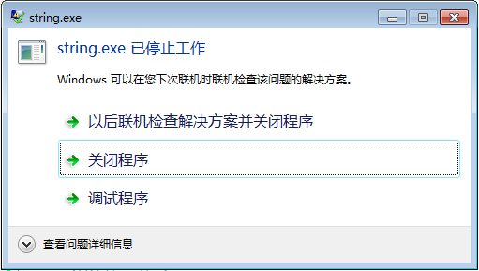
C string
Char array vs. char pointer- intialize/assigment
char *p＝″i love China！″；
char str［］＝“ i love China！″;
p＝″I love u！″；
str＝″I love you″；
*p = ‘I’;
str[0] = ‘I’;
scanf（″%s″，str）；
gets( p ); // p = str;
puts( p+=7);
puts( a+=7);

Slide 56
Exercise
Define a function to get the length of a string (ex3.c)
char str1[10], *pstr="输入：";
printf("%s\n",pstr);
gets(str1);
puts(str1);
int getLen( char* p);
int i = getLen(pstr);
int j = getLen(str1);

Slide 57
Comparing pointers
The difference (subtraction) between two pointers returns the offset in terms of elements (objects)
Relational operators on pointer: compares the address
int strlen(char *s)
{
char *p = s;
while (*p != ‘\0’) p++;
return (p-s);
}
&iArr[1]< &iArr[3]
pi<iArr+3 /* p = iArr;*/

Slide 58
String function
stdio.h
int puts ( char *pc );
char * gets( char *pc);
string.h
int strlen (char * s );
char * strcpy ( char *s1 , char * s2 );
char * strcat ( char * s1 , char * s2 ) ;
int strcmp (char * s1 , char * s2 );
char* strlwr ( char * s )
char* strupr ( char * s )

Slide 59
Common mistakes
#include <stdio.h>
#include <string.h>
void main()
{ int n = 10;
char *src = “Hello world\n”;
char des[n], *p = NULL;
strcpy( des, src ); // strcpy( des, src, n-1 );
n = strlen(des);
strcpy(des, p );
if(p!=NULL) strcpy( p, src );
}

Slide 60
Common mistakes
Use the incremented pointers
#include <stdio.h>
#define ARR_NUM 5
void main()
{
char *src = “Hello world\n”;
char des[ARR_NUM];
char *p = des;
while (*p++ = *src++);
printf(“The original string is %s”, src);
}
Why does it work when calling a function by the pointer as an actual argument?
strcpy(p, src);

Slide 61

Pointer demonstration
\0
void str_cpy(char *des, char *src)
{
int i = 0, len = strlen(src);
for (i = 0; i < len; i++)
{
des[i] = src[i];
}
}
void str_cpy(char *des, char *src)
{
int i = 0;
while (src[i] != ‘\0’);{
des[i] = src[i];
i++;
}
}
void str_cpy(char *des, char *src)
{
while (*des++ = *src++);
}

Slide 62
Example strcpy
Make it possible for chain expressions.
Example:
char *src = “world!”;
char des1[10], des2[20] = "Hello";
int n = strlen( strcpy( des1, scr ) );
strcat(des2, strcpy(des1, src));
des1
‘w’ | ‘o’ | ‘r’ | ‘l’ | ‘d’ | ‘!’
‘\0’ | * | * | *
des2
‘H’ | ‘e’ | ‘l’ | ‘l’ | ‘o’ | ‘\0’
‘\0’ | ‘\0’ | ‘\0’ | ‘\0’ | ‘\0’ | ‘\0’
des2
‘H’ | ‘e’ | ‘l’ | ‘l’ | ‘o’ | ‘w’
‘o’ | ‘r’ | ‘l’ | ‘d’ | ‘!’ | ‘\0’

Slide 63
Example strcpy
void str_cpy(char *des, char *src)
{
while (*des++ = *src++);
}
char*
char *p = des;
return p;
char* str_cpy(char *des, char *src)
{
while (*des++ = *src++);
return des ; // return src;
}

Slide 64
Function returning a pointer
C permits returning one variable to the called by the ‘return’ statement.
What if the caller needs multiple values?
Passing the address of an array as the function argument
Returning a pointer to an array (or structure in Chapter 9)
Declare a function with the type ‘pointer’
type_name * function_name (argue_list);
return a pointer variable in the function definition.

Slide 65
Common mistakes
char * copy(char *p)
{
char temp[50]; int i=0;
while ( temp[i++] = *p++) ;
return temp;
}
int main()
{
char *ps = “Hello”;
char des[50], char *pdes = des;
des = copy(ps);
printf(“%s”, pdes = copy(ps));
return 0;
}

Slide 66
Important notes
Always return a valid address, i.e., the address of a variable in the caller instead of a local variable in the called.
int main()
{
char *ps = “Hello world”;
char des[50]={0};
char *pdes = des;
pdes = ps; ?
printf(“%s”, pdes);
return 0;
}
Memory for string constants
‘H’ | ‘e’ | ‘l’ | ‘l’ | ‘o’ | ‘\0’
Memory for auto variables
ps
0x0012000
pdes
0x0012F80
0x0012000
des
0 | 0 | 0 | 0 | 0 | 0

Slide 67
Important notes
Always return a valid address, i.e., the address of a variable in the caller instead of a local variable in the called.
char * copy(char *p)
{
char temp[50]; int i=0;
while (temp[i] = *p++) {i++;}
return temp;
}
int main()
{
char *ps = “Hello”;
char des[50]={0}, *pdes = des;
pdes=copy(ps);
printf(“%s”, pdes);
return 0;
}
Memory for auto variables
temp
‘H’ | ‘e’ | ‘l’ | ‘l’ | ‘o’ | ‘\0’
Returning an invalid address.
Memory for auto variables
pdes
0x0012FFFF

Slide 68
Example strcpy
char*
void str_cpy(char *des, char *src)
{
while (*des++ = *src++);
}
char *p = des;
return p;
int main()
{
char *ps = “Hello”;
char des[50], *pdes = des;
str_cpy( ps, pdes); ?
printf(“%s”, str_cpy(pdes , ps));
return 0;
}

Slide 69
Example strcpy
int main()
{
char *ps = “Hello”;
char des[50], *pdes = des;
gets( des);
ps = (char*)malloc( strlen(pdes) + 1);
printf(“%s”, str_cpy(ps , pdes));
*ps = ‘h’ ;
…...
free(ps);
return 0;
}

Slide 70
Arrays with variable length
C prohibits auto arrays with variable length
Use the library function malloc(N) to allocate sequenced memory blocks with N bytes. The function returns the initial address of the memory with void type.
How can we use the memory blocks as a normal array, e.g., arr[i], *(arr+i)?
{
int N=4;
/*intend to declare an array to store scores*/
float scores[N];
}

Slide 71
C语言程序的内存映像
内存地址高端
栈 Stack
堆 Heap
命令行参数
局部变量、形参、
返回数据。。。
动态数据区
调用动态内存分配函数获得的数据空间
静态数据区
静态变量／数组
全局变量／数组
常量const
代码段 Code
字符串常量
只读存储区
程序机器代码

Slide 72
Heap usage
General form
Use the pointer as a pointer to an normal array
if( pointer_name !=NULL)
pointer_name [i], *(pointer_name +i)
++ pointer_name , pointer_name = p?
data_type *pointer_name =
(data_type *) malloc( N*sizeof(data_type) )
Examples:
int *pNum = (int *)malloc(m * sizeof(int));
float *pScore = NULL;
pScore = (float *) malloc(n*sizeof(float));

Slide 73
Heap usage
General form
Use the pointer as a pointer to an normal array
pointer_name , pointer_name [i], *(pointer_name +i)
++ pointer_name , pointer_name = p?
Restore p to the original address before calling free
Release manually (your job) the memory to which the pointer points.
free(pNum);
pNum = NULL; /* in case pNum being used later*/
data_type *pointer_name =
(data_type *) malloc( N*sizeof(data_type) )

Slide 74
Heap usage
int * p = NULL , * t ; int i ;
p = (int*) calloc(n, sizeof(int));
if ( p == NULL )
{ puts( "allocation faiure\n“) ; return ; }
for ( i = 0 ; i < 10 ; i ++ )
*(p+i) = 100 + i ;
for ( t = p ; t < p+10 ; t ++ )
printf(“%d ”, *t ) ;//间址访问元素
free( p) ;
p =NULL;
}
p
100
101
102
103
104
105
106
107
108
109
for ( p = t ; p < t+10 ; p ++ )
printf(“%d ”, *p ) ;
p
Memory leakage

Slide 75
Exercise
Find the max string among three C-strings
1. Define data structure;
char str1[20], str2[20], str3[20];
char maxStr[20], *pMax;
2. Input three strings
gets/scnaf()
3. Compare three strings
4. Find the max string and sotre
strcpy( maxStr, pMax);
S | h | i | j | i | a | z | h | u | a | n | g
S | h | e | z | h | e | n
D | a | q | i | n | g
str = str1;
if(str<str2) str = str2;
if(str<str3) str = str3;

Slide 76
Exercise
Function to Compare strings
int strcmp ( char *pc1 , char *pc2);
S | h | i | j | i | a | z | h | u | a
S | h | e | z | h | e | n
if( strcmp(str1，str2)>0 )
pMax = str1;
strcpy(strMax, str1);
D | a | L | i | a | n | \0 | h | u | a
D | a | Q | i | n | g | \0

Slide 77
Exercise
Find the max string among some C-strings
1. Define data structure;
char str1[20], str2[20], str3[20];
char maxStr[20], *pMax;
char str[20][N]; char* pStr[N] ;
2. Input three strings
3. Compare three strings
4. Find the max string and sotre
S | h | i | j | i | a | z | h | u | a | n | g
S | h | e | z | h | e | n
D | a | q | i | n | g

Slide 78
Exercise
/ * 函数功能：查找数组a中是否存在值为key的元素
参数说明：数组首地址a， 数组长度n, 待查找元素key
返回值：若查找成功则返回值为第一个key值元素地址,
否则返回NULL
*/
char* search( char* a, int n, char key );
char *ps = “Hello”, *p ;
if ( search(ps, stlen(ps), ‘l’)) ….
char des[50], *pdes, key;
gets( des); key = getchar();
search( des, stlen(des), key);
How can find sub string in a certain string?
strstr( des, ps);
Notes:
思考：若数组中存在重复的元素，
即要查找的key值有多个，
如何定义并调用函数

Slide 79
Pointer to functions
A function has a type and an address location in the memory.
Functions are loaded into memory in the initialization of a program.
Variables are allocated upon request (extern/local/static).
Pointer declaration
type (*fptr)(formal_argu_list);
Example: double (*p1)( int*, int);
Pointer initialization and assignment
fptr = function_name;
Example:
p1= ave; /*double ave(int*,int); */
Stack
local data
Heap
Static data
Global data
const
Code

Slide 80
Notes for pointers to functions
NO arithmetic operations on pointers to functions.
Function call by a pointer to the function
(*fptr)(actual_argu_list);
Example: (*p1)(a,5); /* int a[5]; double b = ave(a,5);*/
Parentheses around the pointer name for both declaration and indirect function call.
int compare (int i1,int i2) ;
int (*pf) (int , int) = compare;
void sort( int* a, int n, int (*pf) (int , int) );
double caculus( double (*pf) ( double x) ,
int low, int high );

Slide 81
Homework
Exercise 5-2 and 5-3.
Write a pointer version of functions atoi, itoa, and reverse in the textbook.

Slide 82
Chap 5: Pointers and Arrays
Lecture5: Pointers and 2D array

Slide 83
Two-dimensional array
Declaration
type array_name [row_size][column_size];
Storage:
int arr[2][3]={{310,275,365},
{10,190,325}};
arr [2 ][ 3 ]
Column 0
[0][0]
Column 1
[0][1]
Column 2
[0][2]
a [ 0 ] [ 0 ]
a [ 0 ] [ 1 ]
Row 0
a [ 0 ] [ 2 ]
310 | 275 | 365
a [ 1 ] [ 0 ]
[1][0] [1][1] [1][2]
a [ 1 ] [ 1 ]
Row 1
10 | 190 | 325
a [ 1 ] [ 2 ]

Slide 84
Initialization
Initialize rows by rows literally
int arr[2][3]={{310,275,365},
{10,190,325}};
Initialize by a 1D sequence
int arr[2][3]={310,275,365,10,190,325};
Default initialization
int k [ ] [ 3 ] = { {1, 2, 3},{ 4, 5, 6},{ 7, 8, 9} } ;
/The first column to 1 and others zeros*/
int n [ ] [ 4 ] = { { 1 }, { 1 }, { 1 } } ;
/*Wrong, the column number is necessary*/
int m [ 3 ] [ ] = { 1, 2, 3, 4, 5, 6 };

Slide 85
Using 2D array
Access elements of a 2D array
array_name [row_ind][column_ind]
Example: arr[0][1], arr[i][j]
The values of row and column indices should be within the bound[0,M-1]and [0,N-1] for a M*N array, respectively.
Can be used in any context where a variable could.
Access the values one by one.
Access operations for arr[i][j]
Obtain the initial row address from initial address of the array
arr[i] ←→*(arr+i)
Obtain the address offset to the initial row address
Access the memory block given by the address.
arr[i][j] ←→
*(
*(arr+i)
+ j
)

Slide 86
Using 2D array
int a[3][4]，i , j ;
for ( i = 0 ; i < 3 ; i ++ )
{ for ( j = 0 ; j < 4 ; j ++ )
scanf(" %d", a[i]+j) ; //&a [ i ] [ j ]
}
for ( j = 0 ; j < 4 ; j ++ )
{ for ( i = 0 ; i < 3 ; i ++ )
printf(“%5d”, a [ i ] [ j ]) ;
// *( *( a +i) +j)
printf(‘\n’) ;
}
a [ 3 ] [ 4 ]
a [ 0 ] [ 0 ]
a [ 0 ] [ 1 ]
a [ 0 ] [ 2 ]
a [ 0 ] [ 3 ]
a [ 1 ] [ 0 ]
a [ 1 ] [ 1 ]
a [ 1 ] [ 2 ]
a [ 1 ] [ 3 ]
a [ 2 ] [ 0 ]
a [ 2 ] [ 1 ]
a [ 2 ] [ 2 ]
a [ 2 ] [ 3 ]

Slide 87
1. 求矩阵的转置
将一个二维数组a行和列元素互换，
存到另一个二维数组b中。exersise4.c
例如：a= 1 2 3 1 4 7
4 5 6 b= 2 5 8
7 8 9 3 6 9

Slide 88
Example for using 2D arrays
Calculate the average points of every courses for a group of students.
赵 钱 孙 李 张
Math 80 61 59 85 76
C 75 65 63 87 77
English 92 71 70 90 85
char name[ ? ][10], courseName[ ][10] ?
int score[3][5];
float avg[3];

Slide 89
Program
int main()
{ int i,j; float sum, float score[3][5]; /*Scores*/
float courseAverage[3]; /*average scores*/
/*Read scores one by one from the keyboard
for(i=0;i<3;i++)
for(j=0;j<5;j++)
scanf("%f",&score[i][j]);
/*Calculate every course*/
for(i=0;i<3;i++)
{
sum=0; /*Initialization for each course*/
for(j=0;j<5;j++) /*Count in all students*/
sum+=score[i][j];
courseAverage[i]=sum/5;
}
}

Slide 90
Exercise
Write a program to multiply two matrices. The column number of a equals the row number of b.
A= [1 2 3 B= [1 2 3 4
4 5 6] 5 6 7 8
9 10 11 12]
C[i,j]+=A[i][k]*B[k][j];

Slide 91
Why do we need 2D arrays
Many data are organized as rows by columns such as matrices, digital images, and Excel worksheets (data table in a relational database).
The data structure for these data can be naturally chosen as 2D arrays.
Easily and naturally access elements by indices, and more importantly 2D arrays have direct access to rows.
arr[i] or *(arr + i)

Slide 92
Pointers and 2D Arrays
Pointer/address and 1D array
Array name iArr_1D is the address of the first element (initial address)
iArr_1D can be assigned to a pointer with the type of element.
iArr_1D + i means offset i element ahead of the initial.
*(iArr_1D +i) access the element
a
......
int a[5]={1,2,3,4,5};
int *pi = a;
pi+3;
*(pi+3)
*(pi+3) ←→ pi[3]
0x0012F78
1
a [ 0 ]
a [ 1 ]
a [ 2 ]
a [ 3 ]
a [ 4 ]
0x0012F7C
2
0x0012F80
3
0x0012F84
4
0x0012F88
5
......
0x0012F74
0x0012F78
pi

Slide 93
Pointer to array
arr
Address to a 1D array
int arr[2][3], *p;
p = &arr[0][1] ;
p = arr[1]+2;
&*(arr+i), &arr[i]
int* p = arr + i; ??
Declare a pointer to a 2D array
type_name (*pointer_name)[column_size]
Examples:
int arr[2][3]; int (*pRow)[3] = arr;
arr[0]
arr[0][0]
arr[0][1]
arr[0][2]
arr[1][0] arr[1][1] arr[1][2]
arr[1]
arr+1

Slide 94
Pointer to a 2D array
Declare a pointer to a 1D array
type_name (*pointer_name)[column_size]
Examples:
int arr[2][3];
int (*pRow)[3] = arr;
int (*pRow_1)[3] = arr+1;
pRow +1(What’s the type?)
pRow[1] (What’s the type?)
*pRow[1]
*pRow + 1 (What’s the type?)
(*pRow)[1] (What’s the value?)
arr
arr[0]
arr[0][0]
arr[0][1]
arr[0][2]
arr[1][0] arr[1][1] arr[1][2]
arr[1]
arr+1

Slide 95
Address and 2D Arrays
Address and 1D array
Array name iArr_1D is the address of the first element (initial address)
iArr_1D can be assigned to a pointer with the type of element.
iArr_1D + i means offset i element ahead of the initial.
*(iArr_1D +i) access the element at the address
Address and 2D array
A 2D array can be regarded as one 1D array whose elements are 1D arrays.
Array name iArr_2D is the address of the first element (1D array).
iArr_2D can be assigned to a pointer with the type of element (1D array).
iArr_2D + i means offset i 1D array ahead of the initial (the ith row).
*(iArr_2D+i) obtain the element at the address
←→ the initial address of the ith row
[0][0]
[0][1]
[0][2]
[1][0] [1][1] [1][2]

Slide 96
Rewrite the example for average score
int main()
{ int i,j; float sum, float score[3][5]; /*Scores*/
float courseAverage[3]; /*average scores*/
float row_average(float (*p)[5]);/*function declaration*/
/*Read scores one by one from the keyboard
for(i=0;i<3;i++)
for(j=0;j<5;j++)
scanf("%f",&score[i][j]);
/*Call function to Calculate every course (row)*/
for(i=0;i<3;i++)
{
courseAverage[i]=row_average(score+i);
}
}

Slide 97
Sub function
float average(float (*p)[5])
{
int i;
float sum=0;
for(i=0;i<5;i++)
sum+=*(*p+i); /* sum += *p[i]; ??*/
return sum/5;
}

Slide 98
Array of pointers
An array with arr_size elements
Type of elements
Declare a 1D array whose elements are pointers (variables storing addresses)
type_name *array_name[array_size]
Example:
int i = 1, j, k = 10, a[k]={4,5,6,7};
int *ptarr[5]={&i, &k, a, a+i};
Comparing with a pointer to a 1D array
ptarr
......
0x0012F48
0x0012F40
0x0012F00
0x0012F04
0x0000000
......
type_name (*pointer_name)[column_size]
0x0012F00
4
a
int (*pRow)[3] = arr_2d;
......
0x0012F40
10
k
type of the pointer
1
A pointer
0x0012F48
1
i

Slide 99
Array of pointers & 2D array
int main()
{
int iArr[3][4]={1,2,3,4,5,6,7,8,9,10,11,12};
int *pa[3] = {NULL};/*Array of pointers to integers*/
int iRow;
for (iRow = 0; iRow < 3; iRow++)
pa[iRow] = iArr[iRow];
//iArr[0] ←→ *(iArr+0) the address to the first element of the row
for(iRow=0;iRow<3;iRow++)
printf("%d,%d,%d,%d\n",*pa[iRow],*(pa[iRow]+1), *(pa[iRow]+2),*(pa[iRow]+3));
return 0;
}
pa[iRow] = iArr +iRow; ?

Slide 100
Exercise
Find the max string among some C-strings
char str1[20], str2[20], str3[20];
char str[20];
char string[N][20];
strcpy(str , str1);
if( strcmp(str,str2)<0 )
strcpy(str , str2);
if( strcmp(str, str3)<0 )
strcpy(str , str3);
puts(str);
gets( string[i]);
strcpy(str , string[0]);
for(i=1; i<N;i++ )
if( strcmp(str,string[i])<0 )
strcpy(str , string[i]);
puts(str);

Slide 101
Exercise
Find the max string among some C-strings
char str1[20], str2[20], str3[20];
char string[20], *pStr = NULL;
strcpy(str , str1);
if( strcmp(str,str2) >0)
strcpy(str , str2);
if( strcmp(str, str3)>0 )
strcpy(str , str3);
puts(str);
pStr = str1;
if( strcmp(str2,pStr)>0 )
pStr = str2;
if( strcmp(str3, pStr)>0 )
pStr = str3;
puts(str);

Slide 102
Exercise
Find the max string among some C-strings
char* pStr[3]
= {“Shijiazhuang”,“Shenzhen”, “Daqing”;}
pStr[i] = str[i]; //char str[3][N]
char* pMax ＝ pStr[0]; // 指向最大字符串
pStr [ 0 ]
S | h | i | j | i | a | z | h | u | a | n | g
pStr
pStr [ 1 ]
S | h | e | z | h | e | n
pStr[ 2 ]
D | a | q | i | n | g

Slide 103
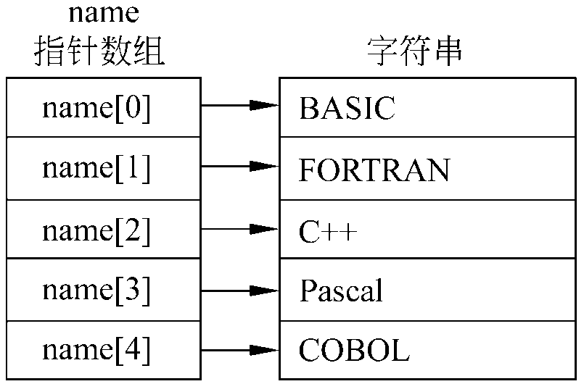
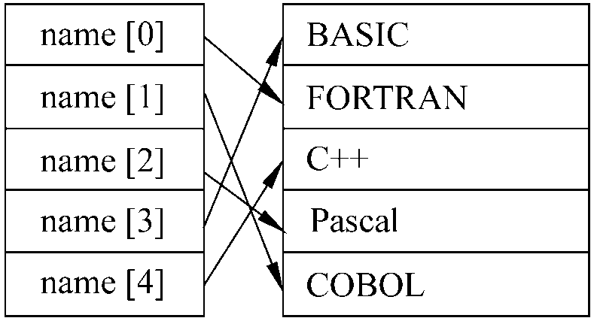
Exercise-sort
″BASIC″,″FORTRAN″,
″C++″,″Pascal″,″COBOL″};
char str[5][ 10] ;
void sort1(char (*p)[10], int n);
char * name[ 5] ;
void sort2(char *p[], int n);

Slide 104
Typical usage of array of pointers
Work as a 2D array with columns of varying length.
An example for an array with fixed column
char name[3][N]= {“China”, “Japan”,“United States”};
Array of pointers
Declare an array of pointers, each pointer pointing to the first element of an array.
These pointed arrays do NOT need to have identical length.
Examples :char *Name[3]= { “China”,“Japan”,“United States”};
This declaration allocate 26 bytes not including the memory for pointers (12 bytes)
Name[0]－>China
Name[1]－>Japan
Name[0]－>United States

Slide 105
Access the elements
Access rows by elements of the array (i.e., pointer to the first element).
Access any single element on the ith row and jth column in the 2D array by name[i][j]
*(name[i] + j)
*(*(name +i) + j)
for( i = 0; i <= m; i++)
{ scanf(“Ns%”, name[i]);
printf(“%s\n”, name[i]); }

Slide 106
Example: arguments of main function
Complete declaration of main function
argc: count of arguments including the program name
argv: an array of pointers to the argument strings separated by white spaces.
Example: project (program) name is myprint, type on the console window (black window)
myprint hello world
argc: passed the value of 3
argv
int main (int argc, const char * argv[])
“myprint”
“hello”
argv
0x0012345
0x0012ABC
0x0012DEF
“world”

Slide 107
Pointer to a pointer
Array name is a constant address of the first element.
Array name of an array of pointers is a constant address of the first pointer (address)
Declaration of a pointer of a pointer
The name of of an array of pointer can be assigned to a pointer to pointer.
type_name **pointer_name;
The pointer points to a pointer
This variable is a pointer

Slide 108
Exercise
What is the value of *ptr and of *(ptr+2) in each case
a. int torf[2][2]={12,14,16};
int *ptr=torf[0];
b. int fort[2][2]={{12},{14,16} };
int *ptr = fort[0];
What is the value of **ptr and of **(ptr+1) in each case
a. int torf[2][2]={12,14,16};
int (*ptr)[2]=torf;
b. int fort[2][2]={{12},{14,16} };
int (*ptr)[2] = fort;

Slide 109
Homework
Write a program to allocate memory for a 2D array with M rows and N columns, where M and N are variables.
We can access the array by a[i][j]

Slide 110
Homework
Write programs for selecting and insertion sorting algorithms.
Write a function that returns the difference between the largest and smallest elements of an array-of-double.
Test the function in a simple program.

Slide 111
Homework
Write a program that prompts the user to enter three sets of five double numbers each.
Store the information in a 3by5 array.
Compute the average of each set of five values.
Compute the average of all the values.
Determine the largest value of the 15 values.
Report the results.
Each major task (b-d) should be handled by a separate function. Accomplish task b by using a function that computes and returns the average of a one-dimensional array; use a loop to call this function three times. The other tasks should take the entire array as an argument, and the functions performing tasks c and d should return the answer to the caller.

